Slide 1
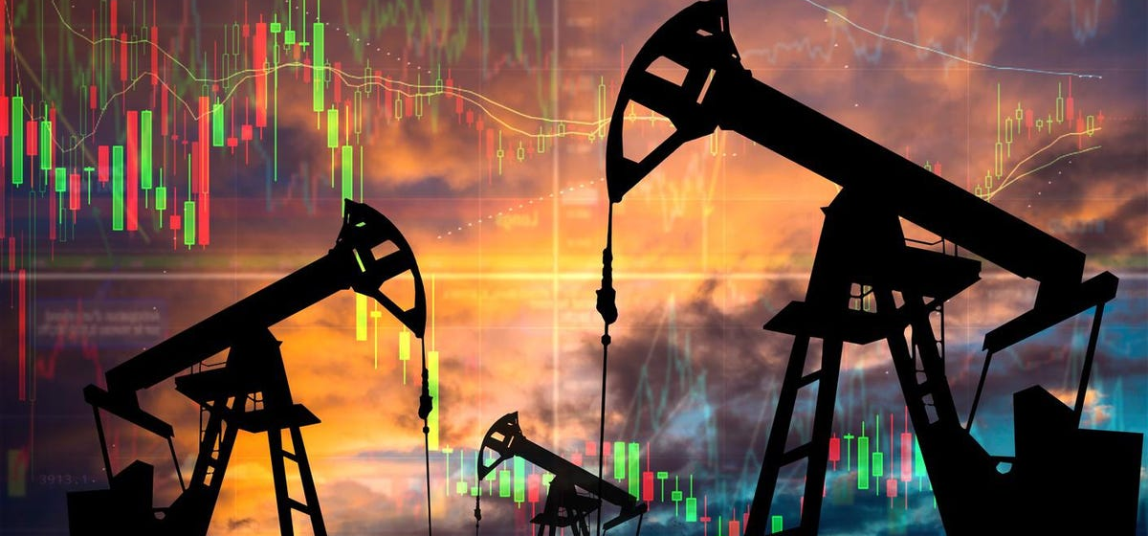
Enhancing the performance of seismic fault detection using Convolutional Neural Network.
Team Members
TABISH SHAIKH (PS ID 2220027), SHASHANK BHUSHAN (PS ID 2093536),
NAZIYA SAYYED (PS ID 2218707), MOHAMMED ABDUL FAHAD (PS ID 2191130),
YASIN REZAZADEH (PS ID 2037451)
Professor: Mohamed Ibrahim Mohamed

Slide 2
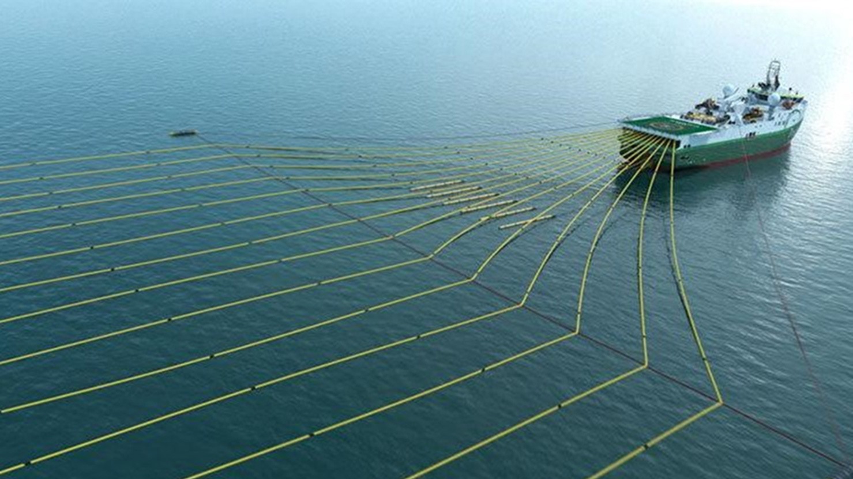
Introduction
Seismic surveys: One of the primary mechanisms used in oil and natural gas exploration.
Data Extraction: The process can be broken down into two main stages:
1. Collection of data
2. Analysis of seismic information.

Slide 3
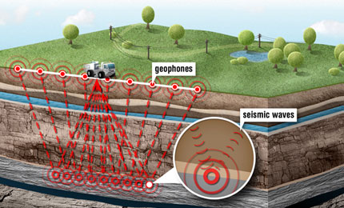
Collection of Data
An energy input is utilized to transmit a wave into the subsurface.
Wave interacts with rock layers and undergoes various effects.
Travel duration of the wave is detected by geophones.

Slide 4

Analysis of Seismic Information
Data is processed and analyzed to identify anomalies that indicate the presence of faults.
First, the seismic data is preprocessed to remove noise and other artifacts
Preprocessed data is then divided into segments, which are small subsets of the seismic data that can be analyzed independently.
Various seismic attributes are calculated from the segmented data

Slide 5
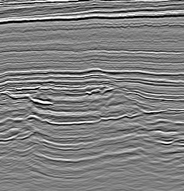
Fault Detection Using CNN Model
Traditional methods rely on human interpretation which can be time-consuming.
Seismic data is preprocessed and then fed into the CNN for training.
CNN learns to detect faults by analyzing the patterns and features in the seismic data
Trained CNN model can then be used to detect faults in new seismic data.
One of the advantages of using CNNs for seismic fault detection is their ability to learn hierarchical representations of the input data

Slide 6
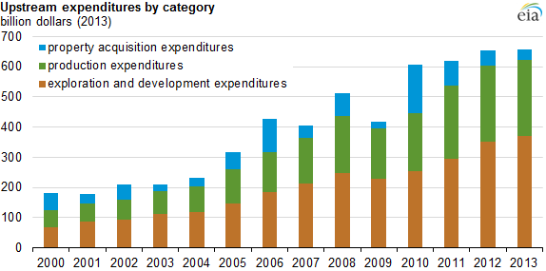
Business Problem
Costs of exploration and drilling make up a large portion of the yearly expenditures of an oil producer, so cost-saving strategies are of high importance.
The possible economic potential benefits of our model are:
Develop and implement automated fault detection methods that can accurately identify faults
Use of advanced technologies, such as machine learning
Large datasets not needed.
Faster exploration cycles.

Slide 7
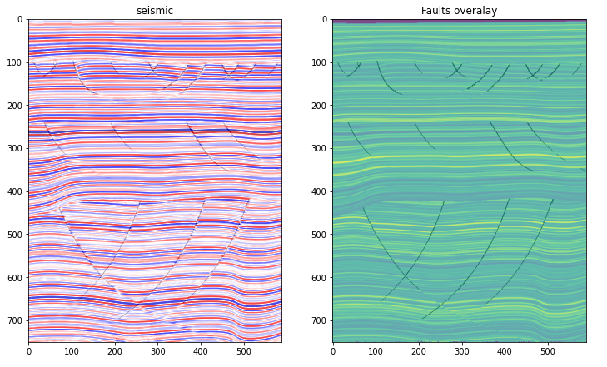
Datasets
To obtain additional information, please follow the link on XEEK.ai where the synthetic data was sourced from the FORCE competition.
An example of a seismic images with fault overlay.
There are 101 in lines, 589 crosslines, and 751 samples in total.

Slide 8
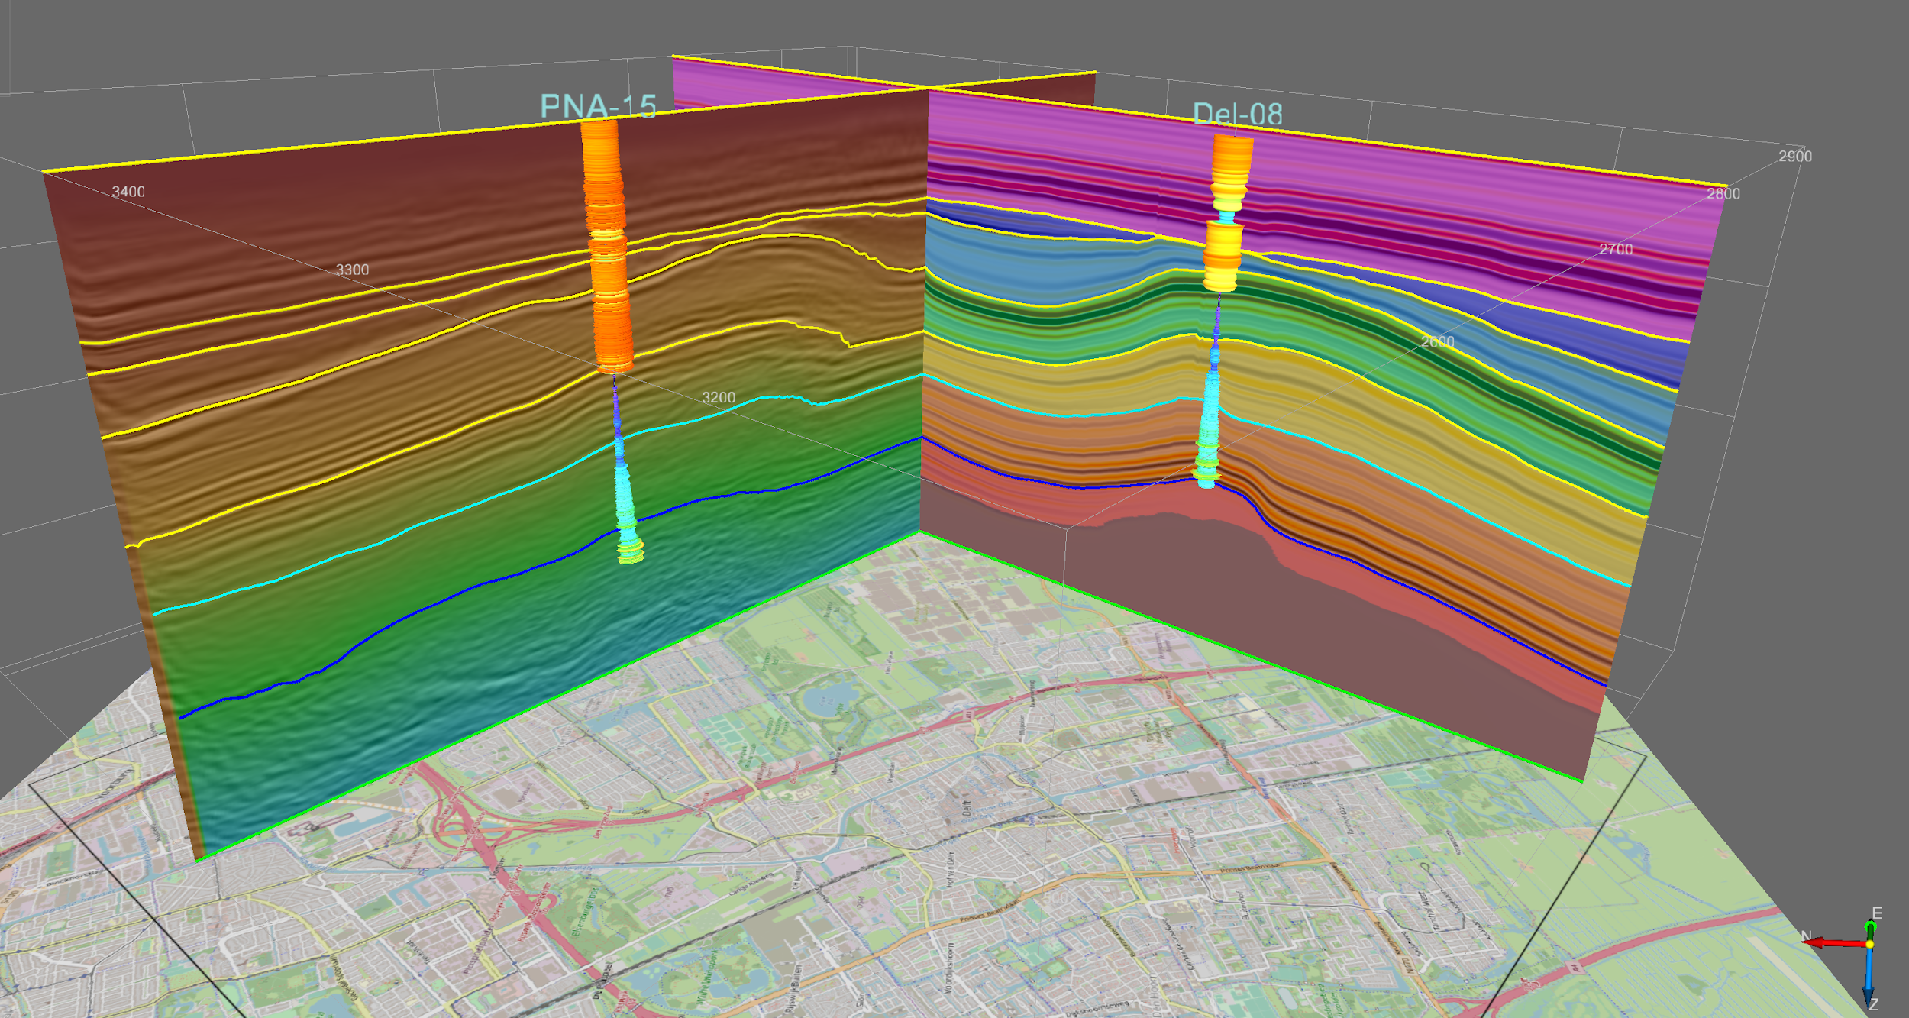
Methodology
We propose a methodology in four steps-
Preprocessing: The raw seismic data is preprocessed to remove noise and enhance the signal-to-noise ratio.
Data augmentation: The preprocessed data is augmented to increase the size of the training dataset.
Training: The augmented data is used to train the CNN based U-Net++ model.
Testing: The trained model is tested on a separate validation dataset to evaluate its performance (loss function).

Slide 9
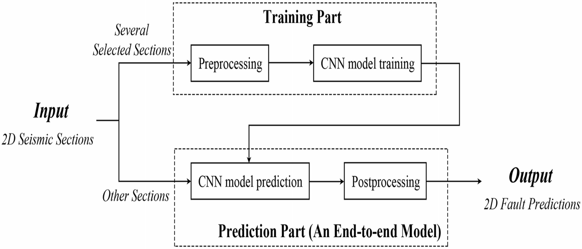
WORKFLOW

Slide 10
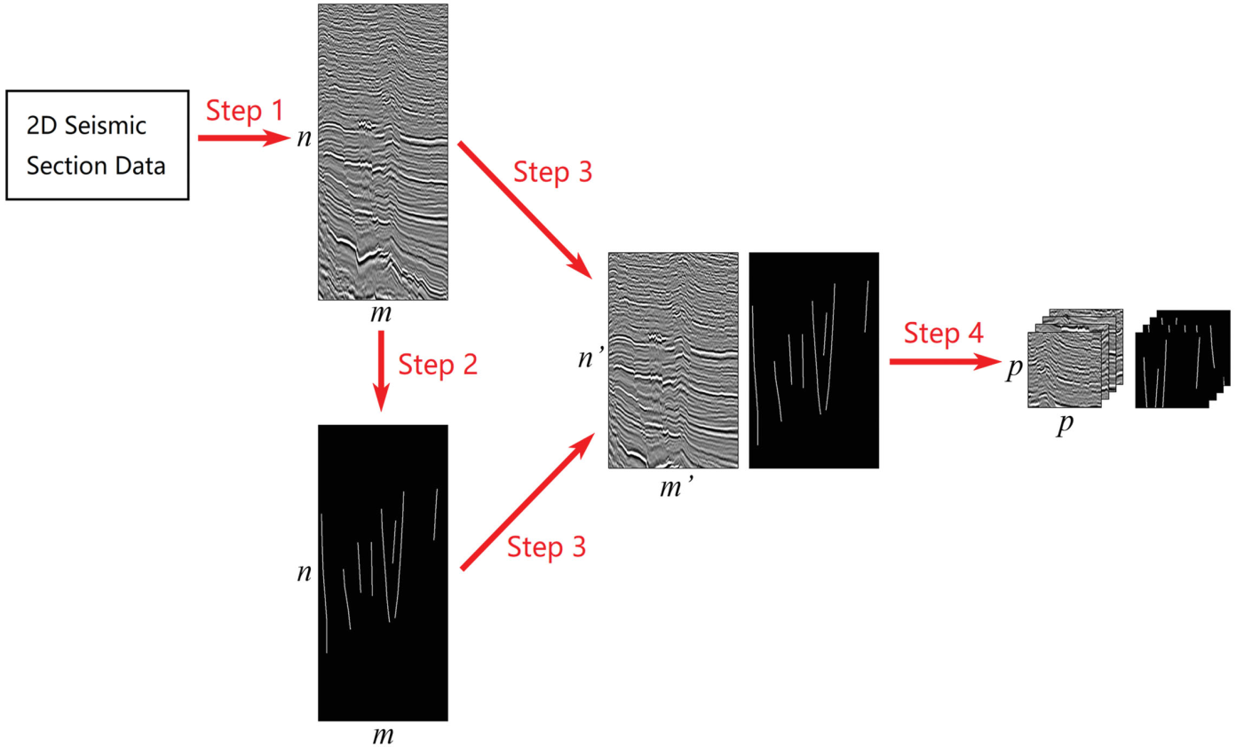
PREPROCESSING
Fault Labeling
Cropped the image to highlight Faults
Generating Samples

Slide 11

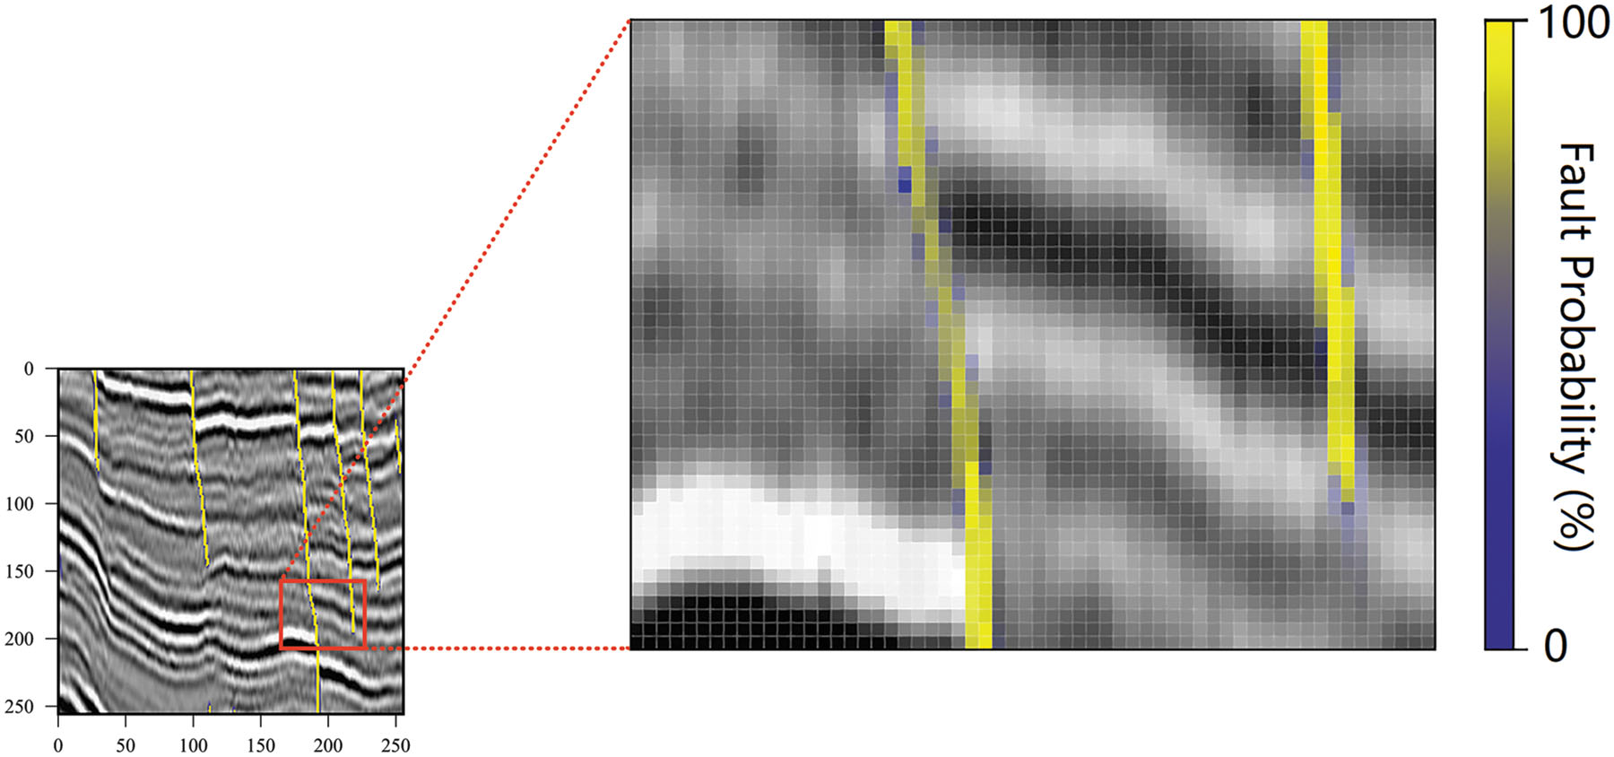
WHY SEMANTIC SEGMENTATION?
Better Interpretation
Improved Accuracy
Reduced Complexity
Automated Analysis

Slide 12
U-Net++ Model:
It is a CNN architecture that has been widely used in various applications.
Recently applied to seismic fault detection and has shown the promising results.
Accuracy rate is very high.

Slide 13
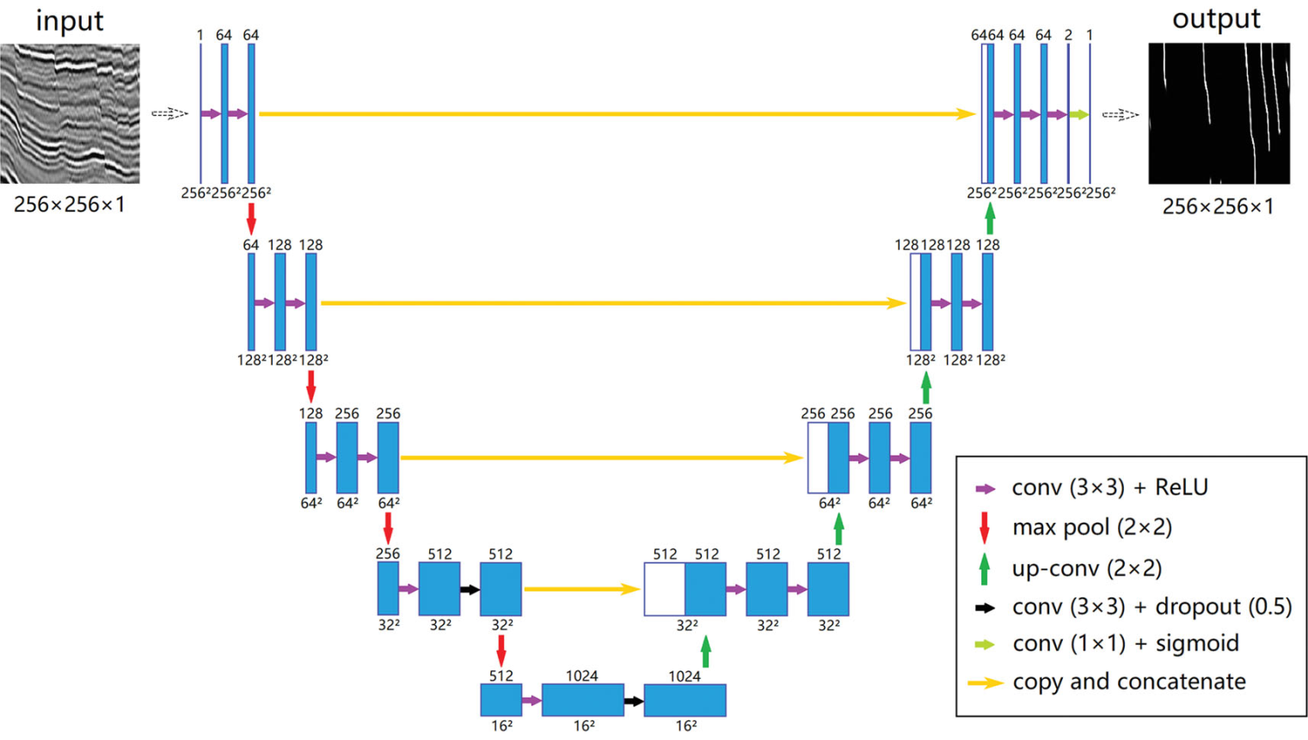
CNN Model Training

Slide 14
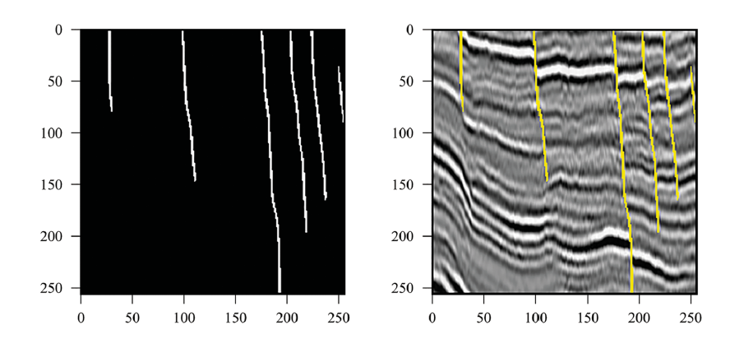
CNN MODEL PREDICTION
The prediction part also has two steps:
CNN Model prediction
Postprocessing the model

Slide 15
RESULTS
Proposed method was tested on a dataset of seismic reflection profiles.
Results showed that the CNN-based approach outperformed traditional methods for fault detection.
CNN Model/U-Net Model achieved an accuracy of 95% compared to 75% for the traditional method.

Slide 16
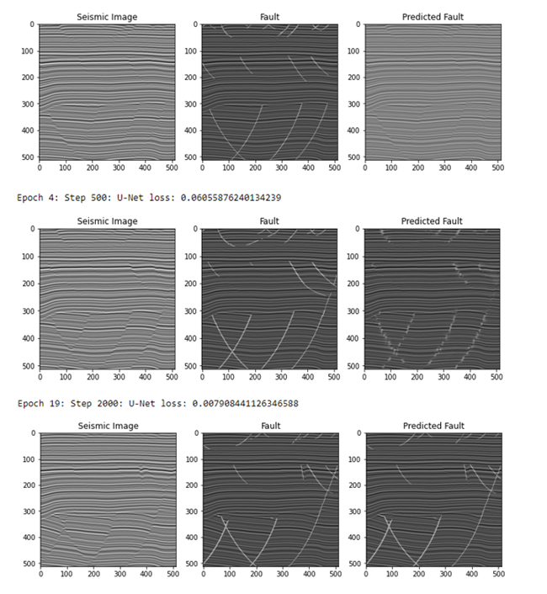
Observation/Graphs

Slide 17
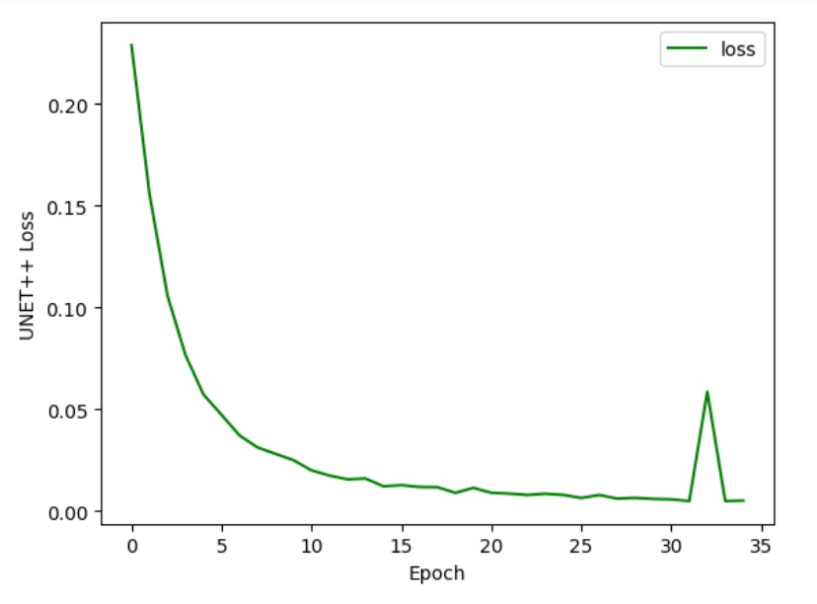
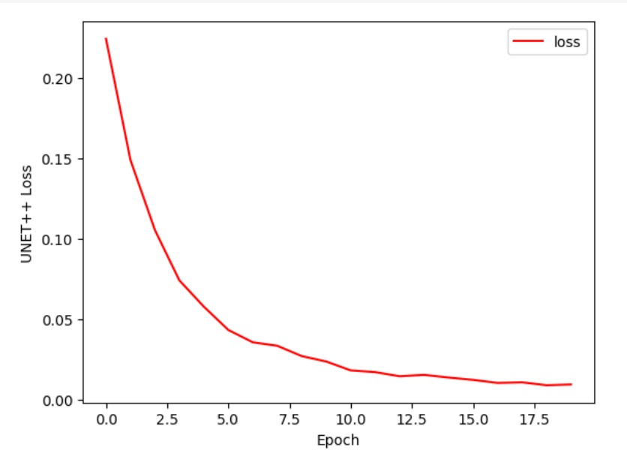
Observation/Graphs

Slide 18
Conclusion
CNNs can significantly enhance the performance of seismic fault detection.
1
Highly
cost effectiveness.
2
Proposed method can reduce the time and effort required for fault detection
3
Improving the accuracy of the results
4

Slide 19


